Slide 1

Enterprise Data & Analytics Strategy Council
Proposed
Terms of Reference

Slide 2
Data & Analytics (D&A) Strategy Governance
What for:
Who by:
Enterprise Strategic Alignment, Budget, Resources, Approval of Data & Analytics Strategy
Top Down
Enterprise Strategic Direction
Executive Data & Analytics Strategy Committee
Vision for Data & Analytics at NG
Link to Business Strategy
Governs NG investment
Executive Sponsors
Heads of Data (Group, GF, BU)
Enterprise Strategic Implementation
Creates Enterprise Data & Analytics Strategy, Roadmap, Policies Methodology & Standards
Strategy to achieve Vision
Aligns Group & BU priorities
Governs Enterprise requirements
Heads of Data
Data Domain Owners
Group Stakeholders (Digital, Arch)
Enterprise D&A Strategy Council
D&A
Strategy
Data Governance
Across
Bottom Up
Entity D&A Strategy Council: BU Strategy to achieve BU Vision
Data Delivery Board: Sets a common delivery method for data and analytics, incorporating strategic direction and guardrails
Data Domain Board: Understandability, Trust, Security of data domain
Entity D&A Strategy Council: Head of Data, Data Governance, Data Architects, Analytics & AI
Data Delivery Board: Grp Data Engineering, Heads of Data
Data Domain Board: Data Domain Owner, Stewards, SMEs
Entity Implementation
Domain, Budget, Resources, Roadmap, Sub-Policy & Standardization
Entity D&A
Strategy Council
Data Delivery Board
Data Domain Board
Operational
Projects: Delivery of data products and/or analytics products. In line with direction from above
Working Groups: Initiated by any board or council to rectify issues or improve capabilities
Projects: Head of Data, Grp Data Engineering
Working Groups: It depends
Operationalize DM & Projects
Data & Analytics Projects
Working Groups

Slide 3
Enterprise Data & Analytics Strategy Council - Terms of Reference
Purpose of Council (to be agreed at first meeting)
Data Council Members
The core purpose of the Council is to own and govern the NG Enterprise Data & Analytics Strategy which should be determined by an alignment of Enterprise (cross-entity) and Entity business strategy drivers. The Council will steer and approve Enterprise Data & Analytics decisions.
Heads of Data
Group – Dan Robertson (chair)
US Gas – Nick Raad
US Electric – Preston Large
UK Electricity – Keith Trilloe - deferred
US Customer - Alex Kanashiro
UK ESO - Niall Branley - deferred
Global HR - Gary Dionne (Mike Ives)
Group Data Office
Data Governance – Kam Bharj
Data & Analytics Architecture –Nishit Ajwaliya
Information Models – Maria Saiz
Data Platforms & Engineering – Bharat Tripathi
Group Data Strategy – Bronwynne Stoddart
Consider extending once ToR established?:
Heads of Data (Global Functions) –
Finance-US - Phil Kluko
Finance-UK - Stuart Tomkinson
Global Vendor - Scott Rodgers
Enterprise Architecture – Keith Vargas
Enterprise responsibilities (cross-Entity):
Enterprise and Entity D&A Strategies and Operating Model alignment
NG Enterprise Data Domains, Data Models, Ref Data
Enterprise Operating Model (common P/P/T/D areas)
Enterprise Data Reference Architecture
Shared external data sets
Common processes, eg Data Catalogue
Agree funding model for Enterprise Investments
BMS Data Management Standards and Framework
NG Data Risk – Data Management
Data project alignment (in line with above)
Agenda
Inputs/Outputs
Frequency & Duration
Strategy Updates
Data Model approvals (cross Entity)
Escalations from Entity DDBs
Inform of Data project scope
Enterprise D&A Architecture approvals
BMS Data Management updates
AOB
Data Strategy updates from Enterprise & Entities
Enterprise – Tool selections, Enterprise Model, Process updates etc
GridStack Blueprint updates
Entity projects – new data projects (significant)
Every other month
1.5-hour duration
Off-line working groups for any urgent cross BU decisions

Slide 4
Proposed agenda for first meeting
October 2021 –
Global Governance Council : Data & Analytics

Slide 5
Enterprise D&A Strategy Council (ED&A SC) | November 2021 – Agenda (suggestions)
Item # | Item | Item owner | Description | For Decision or Information
1 | Approve ToR | Dan Robertson | Proposed ToR has been shared in advance. Owner is looking for agreement in principle, recognising that the ToR will evolve as NG data strategy and operating models mature | Decision
2 | Strategy updates | (any – inform in advance) | Have any of the Data Strategies changed significantly – opportunity to share and align - Consider how we can support and align data strategies going forward | Information
3 | DDB escalations | (any – inform in advance) | BU Data Domain Board escalations – any data decisions (with multiple stakeholders) requiring decision support or exception approval from the Strategy Council - At this meeting we will discuss how this agenda item could be used in future meetings | Information
4 | Data Project Scope | (any – inform in advance) | Details of Strategic Data Projects to be shared in advance at the EDASC for awareness. - At this meeting we will provide a high level overview of current strategic data projects | Information
5 | Group Data Technology | EIA – Nishit Ajwaliya | Updates on technology to support the reference architecture - Overview of implementations and new engagements | Information
6 | Enterprise Data Model | Maria Saiz | ‘Product Owner’ is looking for agreement from the EDASC that BUs/GFs will by default align with the Enterprise Data Model and any exceptions will run through working groups and come to the EDASC for approval | Decision
7 | Business Glossary and Enterprise Data Catalogue | Kam/Diane | ‘Product Owner’ is looking to establish stakeholders from the EDASC to be involved in shaping the processes and roles associated with BG & EDC activities | Decision
 | AOB
 | Summarise decisions and actions | Dan Robertson | Confirm decisions and actions

Slide 6
Agenda #2: Data Strategy Updates | Collaborative definition and shared vision
1
Identify existing strategies for input and alignment
Agree contents and template
Establish key stakeholders
Agree timelines
Discovery
2
Group Data Strategy & Operating Model
Governed by (ambition)
Enterprise Data & Analytics Strategy Council
Definition
Refresh existing content or draft new
3
Sharing & Alignment
Effective stakeholder communication
Opportunities for further collaboration
4
Execution & Tracking
Establish and agree reporting and governance process
What is the optimum timeframe for all business units? Is it pragmatic to align across BUs?

Slide 7
Agenda #3: BU Data Domain Board Escalations
Nothing to share this month
Consider owners and next steps to put this into action…

Slide 8
Agenda #4: Strategic Data Projects
Current, in progress, Strategic Data Projects (overview):
Project | Entity | Driver | Data Scope | Data Capability Scope
Workforce Data Domain | Global HR | Improve HR processes and mitigate risks and issues created by poor data. MVP1 – IAM | All BUs, Workforce data | Master data (workforce), manage data (glossary, catalogue, cleanse), Share data (batch loading onto EDP)
Customer Data Project | US Customer | MVP1 - | US BUs, Customer data | Master data (customer), manage data (glossary, catalogue, cleanse), share data (batch loading onto EDP), utilise data
AMI | US CBU, EBU, GBU | MVP1 - | US BUs, Smart Meter data | Manage data (glossary, catalogue, cleanse), share data (batch and stream data onto EDP), utilise data
Digital MVPs/GridMod | US EBU | MVP1 - | US EBU, T&D, Asset data | Manage data (glossary, catalogue, cleanse), share data (batch and stream data onto EDP), utilise data

Slide 9


Agenda #5: Enterprise Data Platform (EDP) Updates
Data Integration and Orchestration (DI&O) –
Tool is available for the development
Initially Asset GridStack, Customer Data Platform, Workforce Data Domain to use Matillion
Change Data Capture (CDC) for US Customer Source systems (CRIS/CSS)
None of current CDC tools support DB2z
Selected 2 finalists - HVR and Qlik Replicate
Next Steps:
Base Security assessment
Procurement and commercial discussion
Select final tool and sign contract by Nov 2021
Master Data Management –
Tool is available for the development
Customer Data Platform (CDP)
Data analysis, mapping, and business requirement in process
First MVP is expected in Feb-March 2022
Workforce Data Domain (WDD)
Data analysis, mapping, and business requirement in process
First MVP is expected in Match 2022

Slide 10
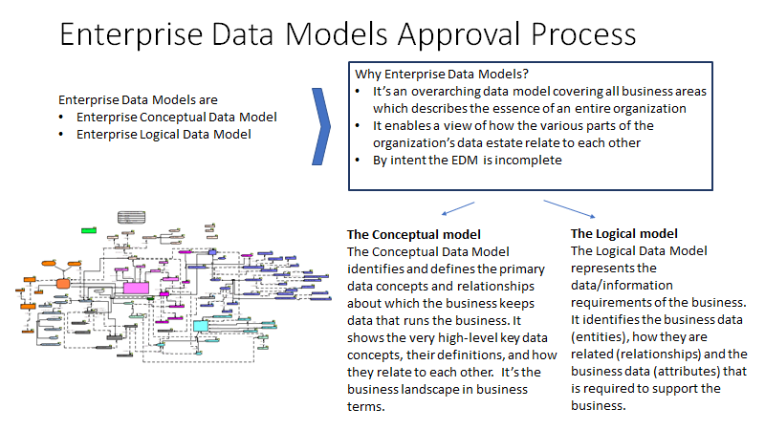
Agenda #6:

Slide 11
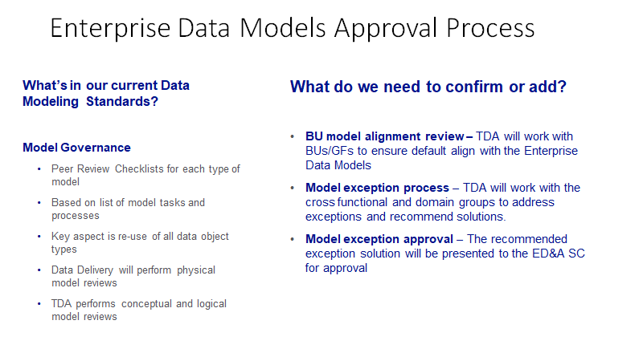
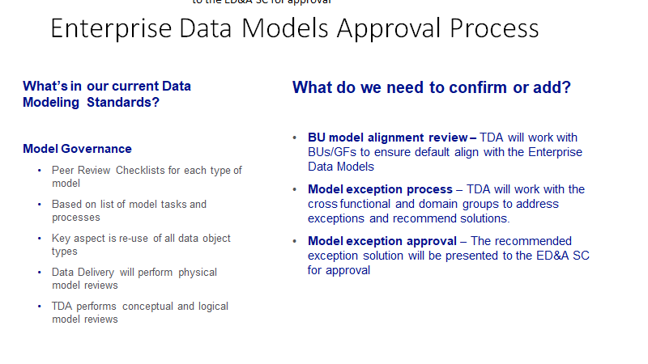
Agenda #6:

Slide 12
Agenda #7: Business Glossary & Enterprise Data Catalogue
All, current, strategic, data projects should be cataloguing data
New tooling has been selected (Informatica suite) and processes need to be established to catalogue data across the NG Enterprise
Current projects (WDD & CDP) are establishing processes for glossaries and catalogues:
Linking business glossary to metadata catalogue
Process to production
Establishing Data Catalogue user stories
Establishing operating model (roles, hierarchies etc)
Identifying cross-functional dependencies:
Cost centre, location
We need to ensure we define, test and establish reusability for BUs

Slide 13
Business Glossary – Change Process
Finance Data Community or Finance Customers |  | Identifies need to modify Business Glossary Terms. Suggests new definition. If other than the Finance Data Owner, the Finance Data Owner is contacted regarding the change.
Finance Data Owner/Stewards |  | Verifies need for modification Assesses impact of change (Stakeholders, Documentation, Training) Notifies Finance Data Office
Finance Data Owner |  | Approves / Rejects Escalates approval request Socializes and prioritizes change request to support processes Updates the issues log
Finance Data Steward |  | Coordinates changes to the Finance business glossary Coordinate changes to the Global (IT) business glossary and with the Reporting Center Of Excellence (RCOE).
Finance Data Steward and Finance Data Office |  | Publishes and Communicates business glossary changes to stakeholders
Identify business need to modify business glossary
Verify request and assess impact of change to business glossary
Approve and prioritize OR
Escalate request for approval
Update business term(s) and coordinate necessary changes
Publish and communicate changes
Notes:
Finance has started collecting terms for our Business Glossary so we need to formalize the change process.
We created this swim lane diagram showing how the process would work
The process depicted here would address decisions that could be made by the Data Owners. However, there may be occasions where different Finance areas have concerns

Slide 14
Business Glossary – Escalation Process
Finance Data Owner |  | Notifies Finance Data Office regarding escalation If other than the Data Owner, the requester is contacted regarding the change.
Finance Steering Committee |  | Verifies need for modification Assesses impact of change (Stakeholders, Processes, Documentation, Training)
Finance Data Owner |  | Coordinates changes to the Finance business glossary
Finance Data Steward and Finance Data Office |  | Publishes and Communicates results to stakeholders (including Global IT and the RCOE) Cross references and ensures the change is reflected in all supporting documentation and communications
Escalates request to modify business glossary entry
Approve/Reject request for modification or
Refer to Global DG Council for approval
Prioritize and Coordinate Updates for approved requests
Publish and communicate changes
Notes:
On those occasions where different Finance areas have concerns or different opinions, we have a Steering committee to help us make those decisions.
But what happens when concerns or challenges are brought up by areas outside of Finance.
Since they are impacting multiple areas, they must be considered Critical Data Assets and we need a process for resolving these issues.

Slide 15
Appendix

Slide 16
Decision Log
Decision# | Decision | Detail | Meeting date (update)

Slide 17
Action Log
Action# | Action | Detail | Owner | Update (plus date of update)

Slide 18
Enterprise Data Governance
NEW initial baseline maturity assessments were conducted for Electric US and Global Procurement
Quarterly maturity assessments where conducted for US Customer and US Finance Q1, Q2:
Domain | Preliminary Maturity
US Electric | ~1.9
Global Procurement | ~2.5
Domain | Q1 | Q2
US Customer | 1.46 | 2.04
US Finance | 2.5 | 2.6
US Gas | 2.4 | --- (To Be Determined) Delay due to Bandwidth

